Slide 1

Open Access at IEEE
Workflow for Authors
Navigating the open access publication process from submission to acceptance to OA funding

Slide 2
Author Process
Submission, acceptance and funding

Slide 3
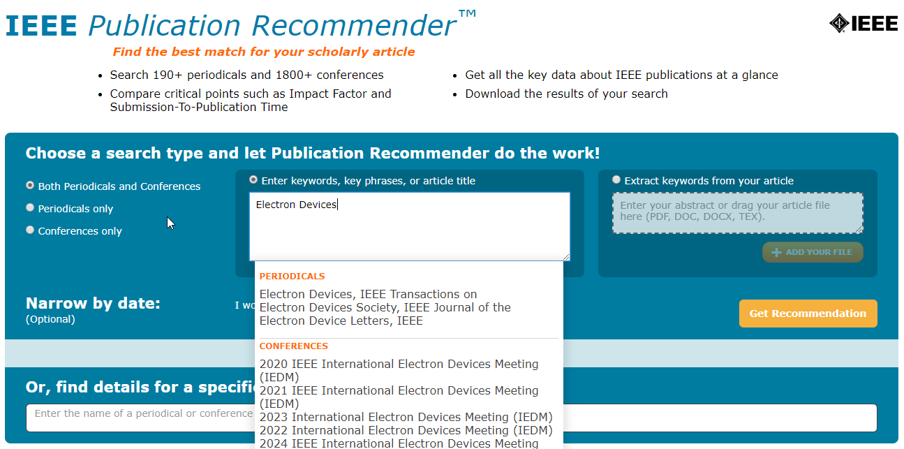
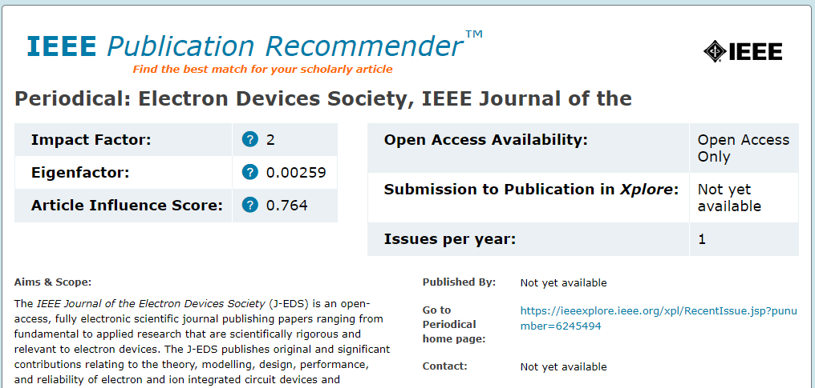
Submission – Step 1
https://publication-recommender.ieee.org/home
IEEE Publication Recommender helps authors find the most suitable journal and displays journal’s OA Status with submission URL
Note: Open Access status clearly displayed in results.

Slide 4
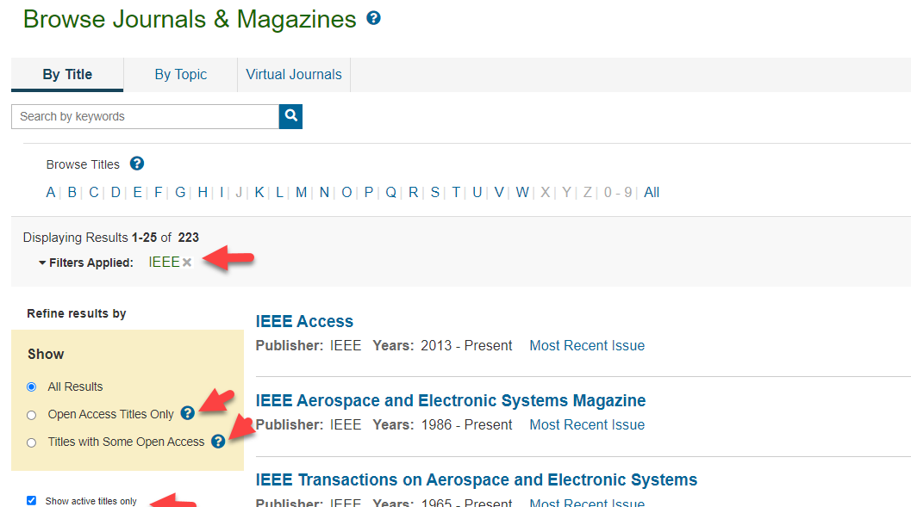
Submission – Step 1 – in IEEE Xplore
https://ieeexplore.ieee.org/browse/periodicals/title?refinements=Publisher:IEEE&showActiveTitlesOnly=true

Slide 5
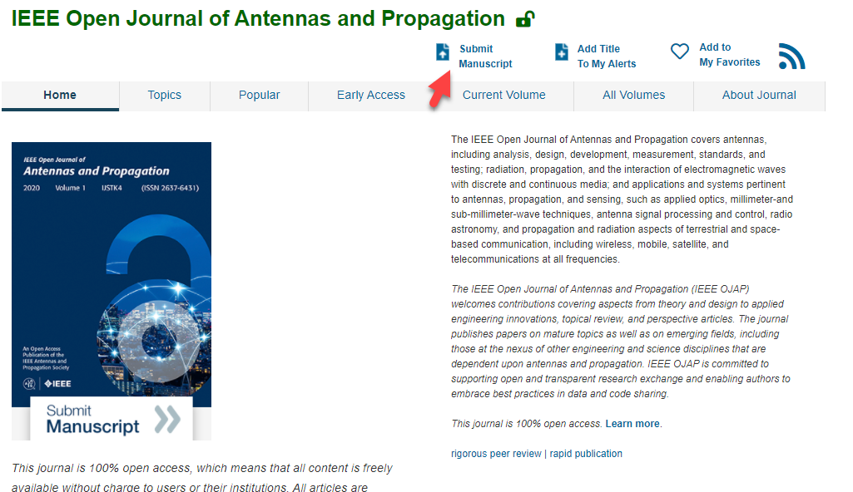
Submission – Step 1 – in IEEE Xplore

Slide 6
Submission process
The corresponding author will complete the submission process.
  Authors submitting to fully OA journals will be asked to accept OA terms and charges during Step 1.
  Authors submitting to hybrid journals will not be asked to select OA until after acceptance.

Slide 7
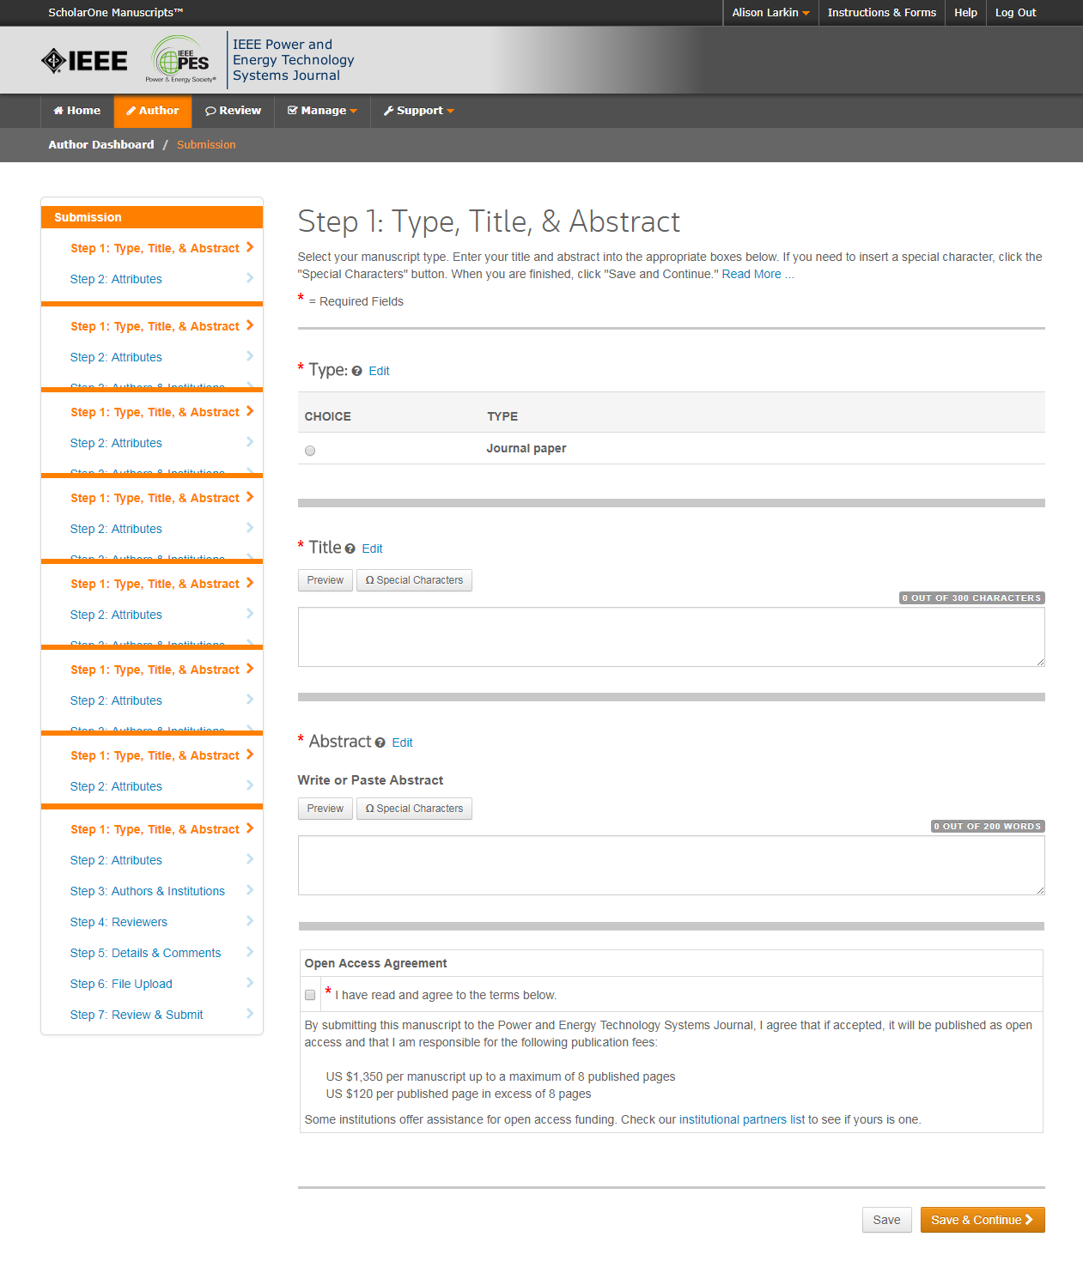
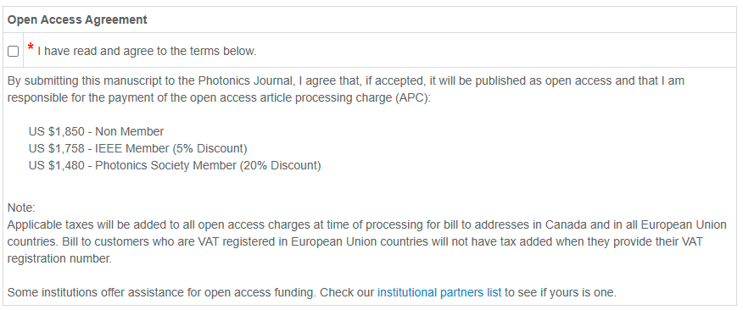
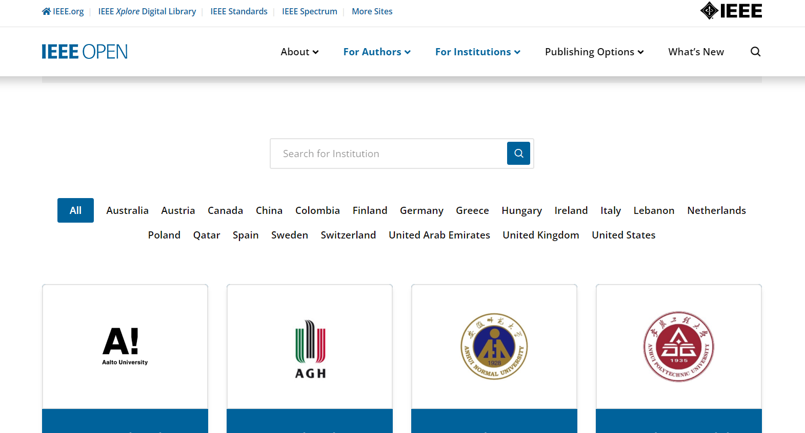
Submission – Step 1 – Fully OA journal
Note: There is some pricing variation among journals.
More detailed article processing charge (APC) information can be found at https://open.ieee.org/index.php/for-authors/article-processing-charges/.
The institutional partners list goes to https://open.ieee.org/for-institutions/institutional-partners/

Slide 8
Submission process – Step 2
General requirements may vary journal to journal, but there are several key elements that are important to complete at this time to ensure proper Open Access processing later during publication
  Assigning Authors
  Identifying Institution

Slide 9
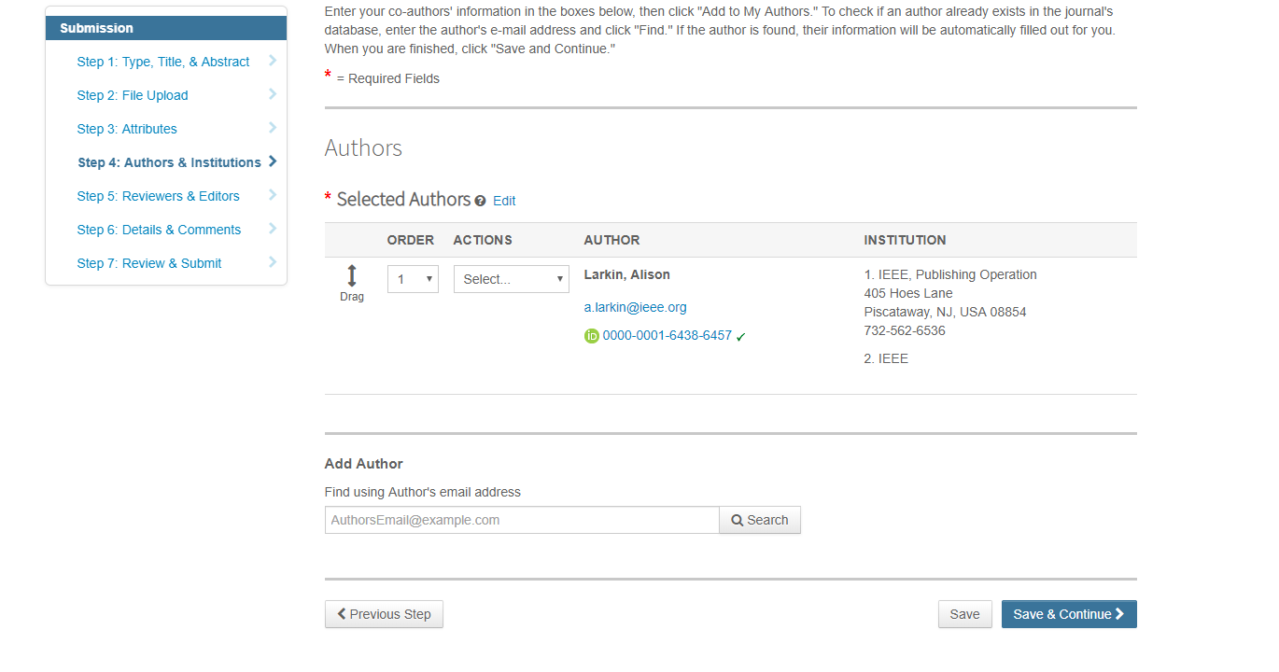
Adding Authors During Submission
The corresponding author enters all co-author information.
If the co-author does not have an account, the corresponding author will create one, and add institution data.
The corresponding author’s institution data will be used to match the author with their institutional OA account.
Note: Some institutions will not fund publication if their institution is not listed first.
PLEASE USE your INSTITUTIONAL EMAIL ADDRESS!

Slide 10
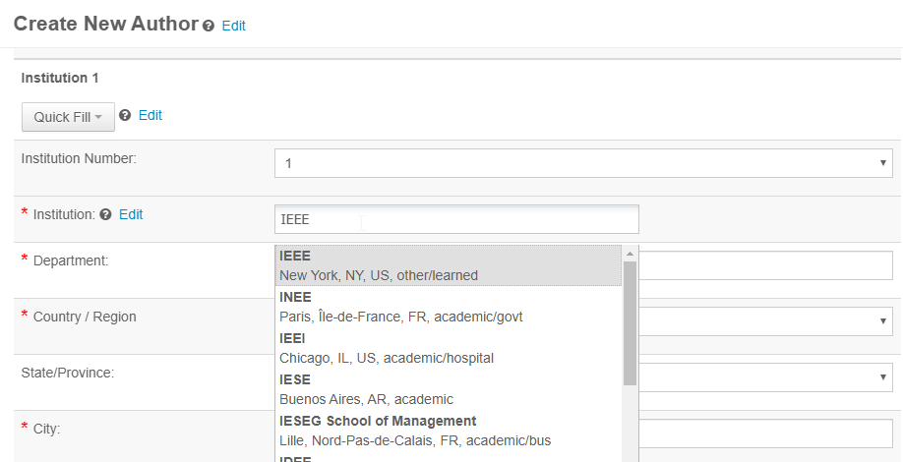
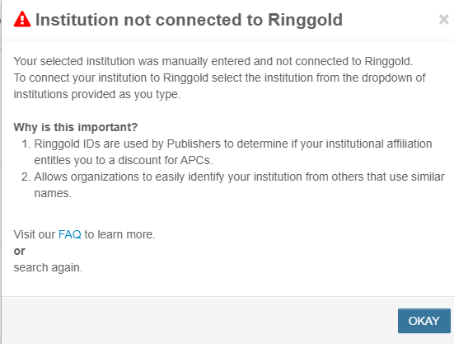
Connecting Ringgold During Submission
Ringgold IDs are integrated in the submission system.
When adding an author’s institution information, the system will present the author with a list of institutions that most closely match what the author has entered.
If the author does not tie the affiliation to a Ringgold, a warning message appears.
PLEASE SELECT THE INSTITUTION NAME FROM THE DROPDOWN

Slide 11
Acceptance
If the manuscript is accepted, the author will be prompted to upload the final files and choose a copyright license.
After acceptance, hybrid journal authors will choose whether to publish open access.Open access is “opt-in” for hybrid titles.

Slide 12
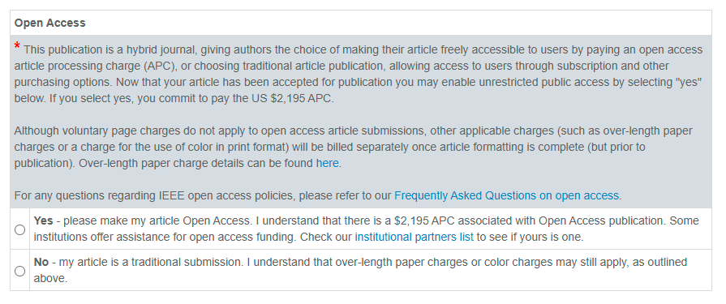
Post acceptance – hybrid review
IEEE supports author choice when publishing in a hybrid journal.
The institutional partners list goes to https://open.ieee.org/for-institutions/institutional-partners/

Slide 13
Post acceptance – Authors publishing open access may choose between CC-BY or CC-BY NC-ND
After acceptance, authors will be prompted to choose their license using the Electronic Copyright Form (eCF).
Authors publishing open access may choose between:
  A CC-BY 4.0 license (in which the author retains copyright and the article is published open access).
  A CC-BY NC-ND license (a more restrictive license than CC-BY in that the article may not be reused for commercial purposes, nor may the article be changed in any way.)
Authors should confirm any license restrictions set by the institution.

Slide 14
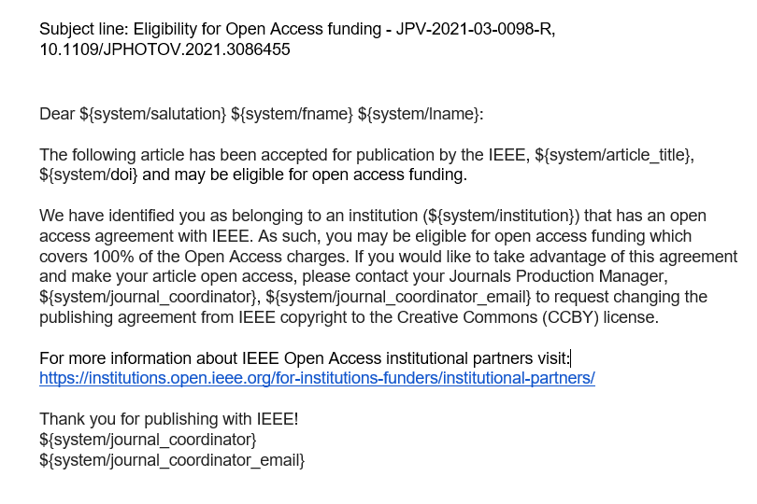
Post acceptance – hybrid journal
Authors who choose “traditional submission” in a hybrid title will receive an email informing them of the opportunity to publish OA if an active OA agreement is present based on the corresponding author’s affiliation.
Note: The email is sent only if the profile associated with the article is set a “Touch free” in RLSC.

Slide 15
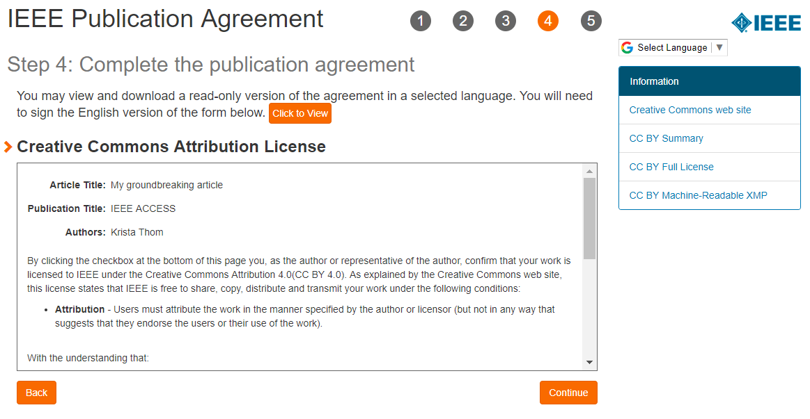
IEEE Electronic Copyright Form (eCF)
Confirm that the article details are correct.
Confirm the paper’s originality
OA Authors must agree “to pay” an APC (Article Processing Charge)
Select and sign CC-BY license type
Download a copy of the agreement

Slide 16
RightsLink for Scientific Communications (RLSC) in TouchFree
All open access charges are handled through CCC RLSC.
Authors do not need to request funding through RLSC (in TouchFree workflow) as this is done when a match is made between the manuscript metadata and the institution’s profile in RLSC
Institutional profiles are matched using author-provided affiliation data including email domains and/or Ringgold IDs.

Slide 17
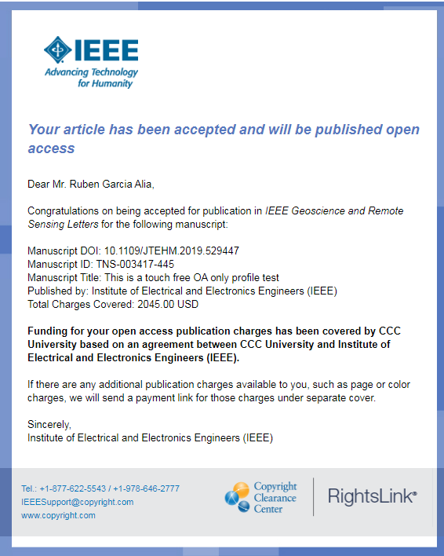
Approving requests
The author receives an email when the request is approved
or denied by the admin.

Slide 18
Need additional assistance?
IEEE Open Site
  https://open.ieee.org/
IEEE Author Center
  https://ieeeauthorcenter.ieee.org/
IEEE Xplore Digital Library
  https://ieeexplore.ieee.org/
IEEE Publications Recommender
  https://publication-recommender.ieee.org/

